Slide 1
MEX-USA Trade and NAFTA
Off-Code Changes
Luis Armando Alvarado Rodríguez
Sebastián Ocampo Palacios

Slide 2
Aesthetical Off-Code Changes
You will need “MEX-USA_IEN.png”, “SMT_N.png”, “SUT_N.png” from International Trade NAFTA GitHub repository.
Know that the size of the central visualization (MEX-USA_IEN.png) is 4.38 x 6 in. (HxW), while the smaller graphs are 2.12x6.
Font is Times New Roman and the colors are
Exports (HEX: #c64756 )
Imports (HEX: #184d47)
Add main title, caption and legend.
Group and copy+paste as picture.
Right click, select Format Picture, Fill and choose Solid Fill (“White).
Save as Picture.

Slide 3
Interpretaciones
Gráficas
* IET: Muestra de Importaciones y Exportaciones de Estados Unidos con México. Por lo tanto, la interpretación deseada es que las importaciones de US sean las exportaciones de México y viceversa.
*RoT: Exportaciones de US-Mex respecto de las exportaciones totales del mundo. Pertinente voltear la interpretación y dirigirla hacia México. (Export US-MEX / Export World).
*MoT: Obtiene las tasas que existen entre las importaciones de Estados Unidos de México con respecto del total de exportaciones de este país (y viceversa). (Export_US-Mex /Impor_Mex)

Slide 4
The increase in MEX-USA Trade after NAFTA
Methodological Note: Seasonal and inflation adjusted monthly data. We display the real changes with NAFTA trade agreement partner, the USA , from 1990 to 2005.
Sources: USA Census Bureau for Fore​ign Trade and INEGI.
Authors: Sebastián Ocampo and Luis Alvarado

Slide 5
Legend
Mexican exports to the USA
Mexican imports from USA

Slide 6
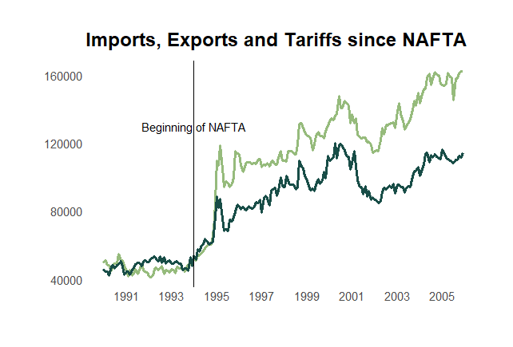
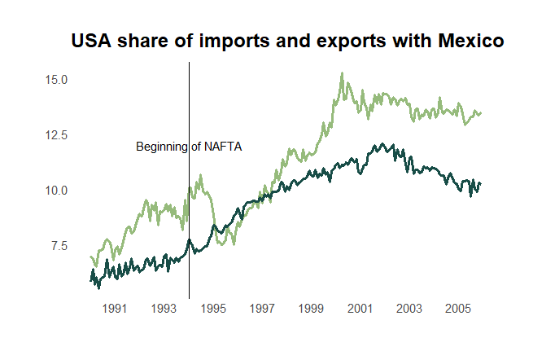
Imports and Exports
Share of imports and exports with Mexico
Real values in millions of dollars
Porcentage
Imports
Exports

Slide 7
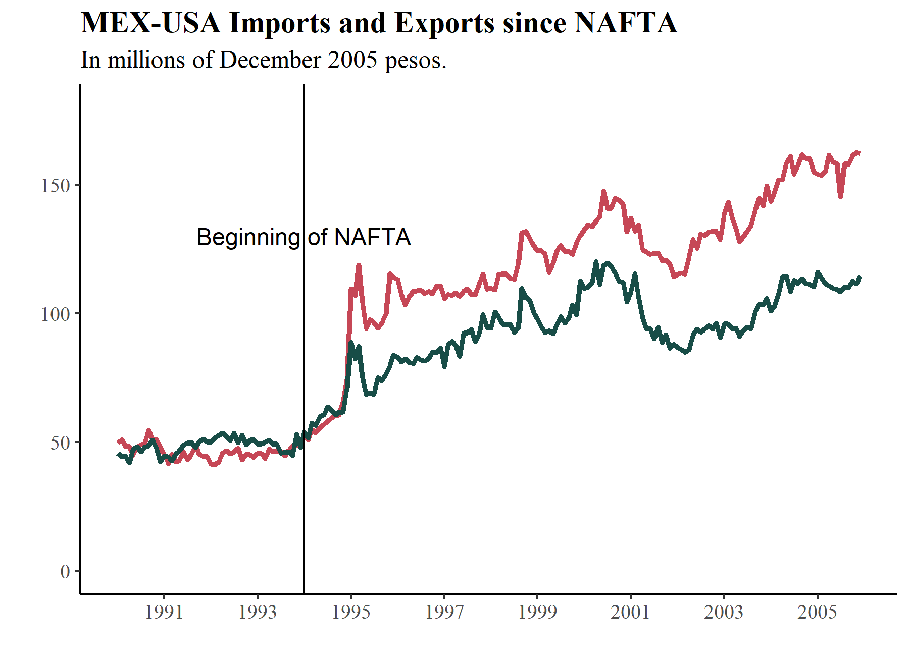
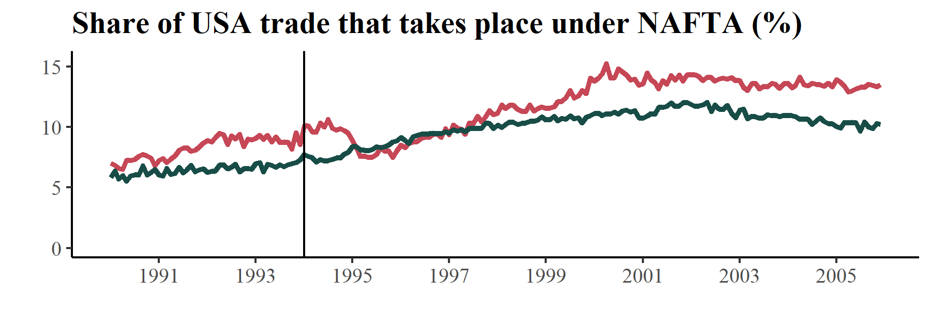
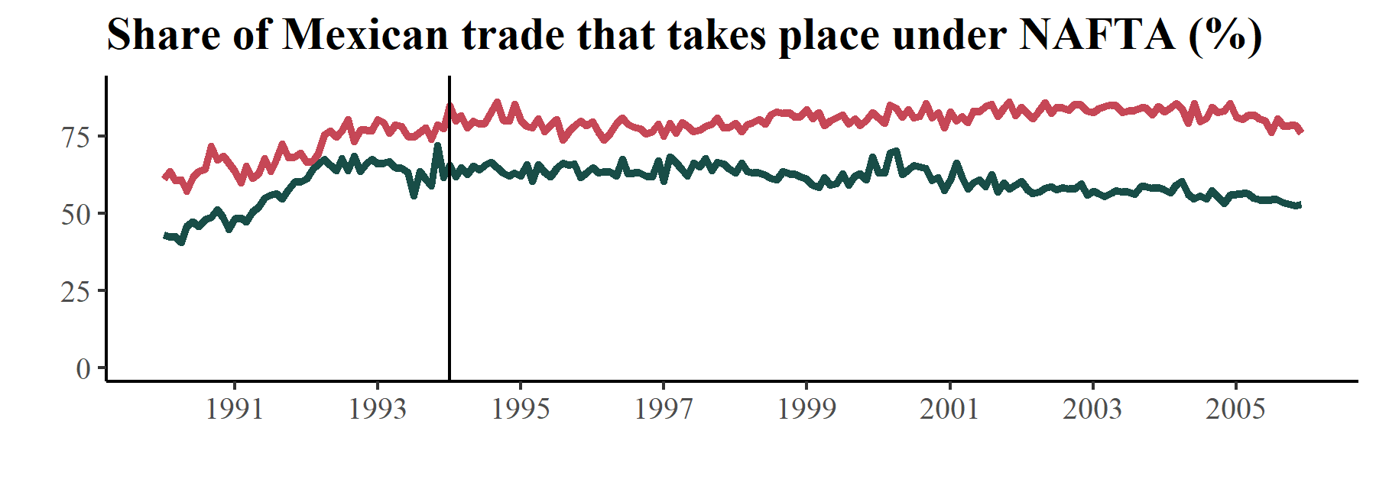
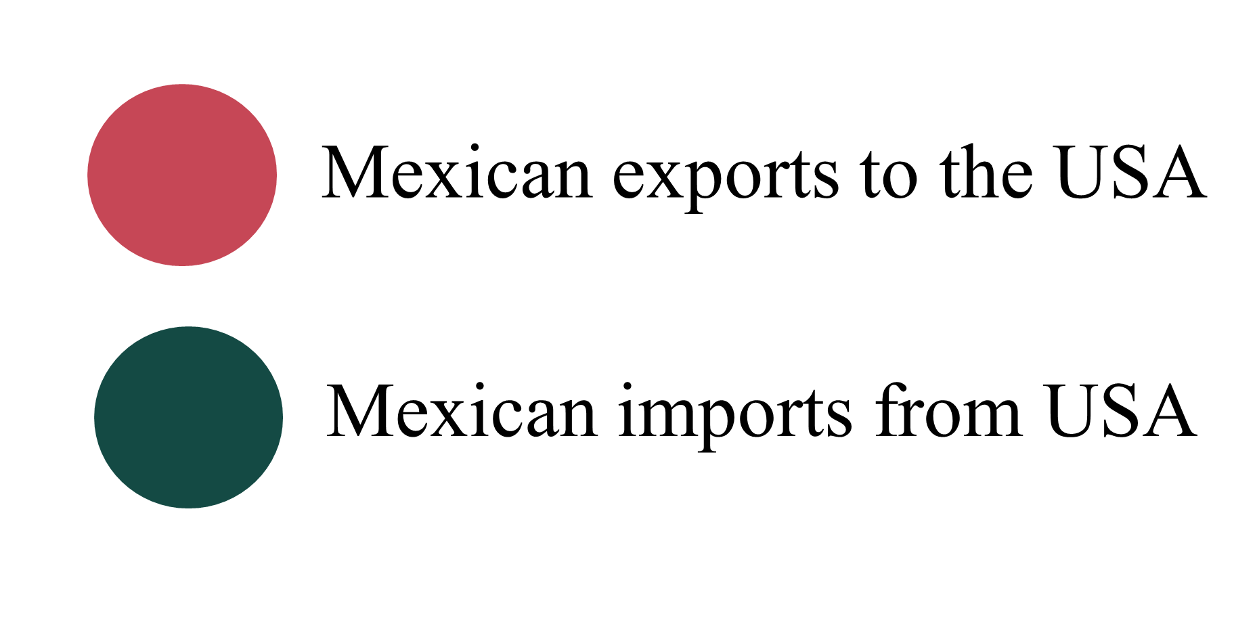
The increase in MEX-USA Trade after NAFTA
Beginning of NAFTA
Methodological Note: Seasonal and inflation adjusted monthly data. We display the real changes with NAFTA trade agreement partner, the USA, from 1990 to 2005.
Sources: USA Census Bureau for Fore​ign Trade and INEGI.
Authors: Sebastián Ocampo and Luis Alvarado

Slide 8
